Slide 1
COURSE NAME: COURSE CODE:
ARTIFICIAL INTELLIGENCE
CIS 412
SYED TANGIM PASHA
LECTURER,
DEPARTMENT OF COMPUTING AND INFORMATION SYSTEM (CIS)
DAFFODIL INTERNATIONAL UNIVERSITY (DIU)
DHAKA,BANGLADESH

Slide 2
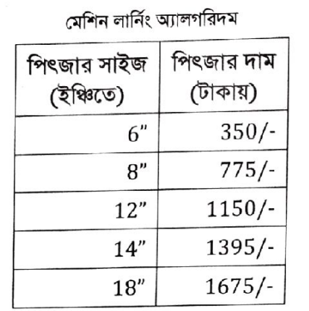
LINEAR REGRESSION
Linear Regression is a Machine Learning algorithm based on supervised learning. It performs a regression task.
Linear Regression performs the task to predict a dependent variable value (Y) based on a given independent variable (X).

Slide 3
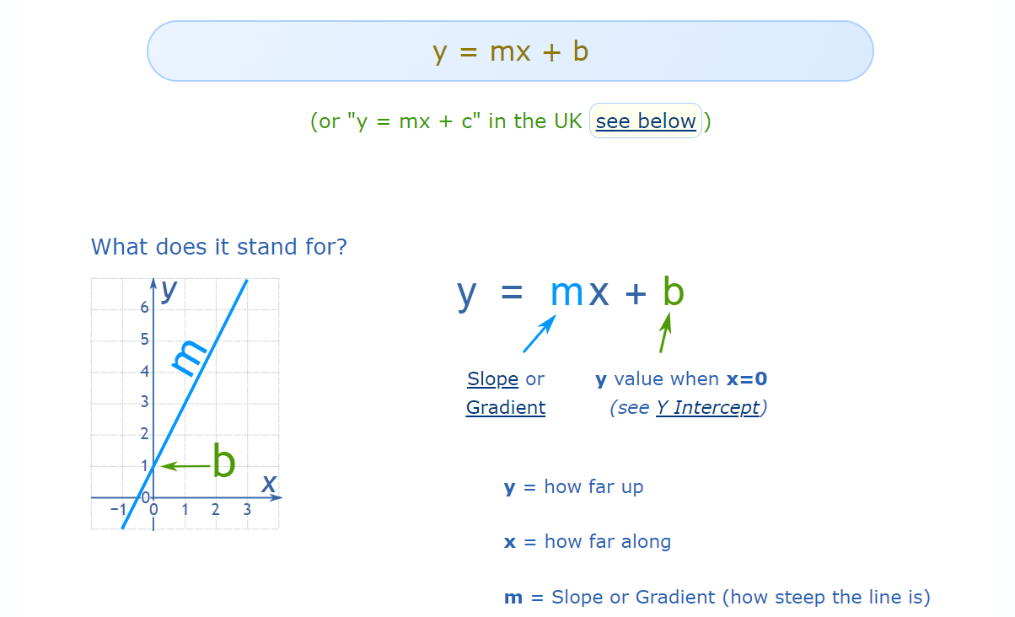

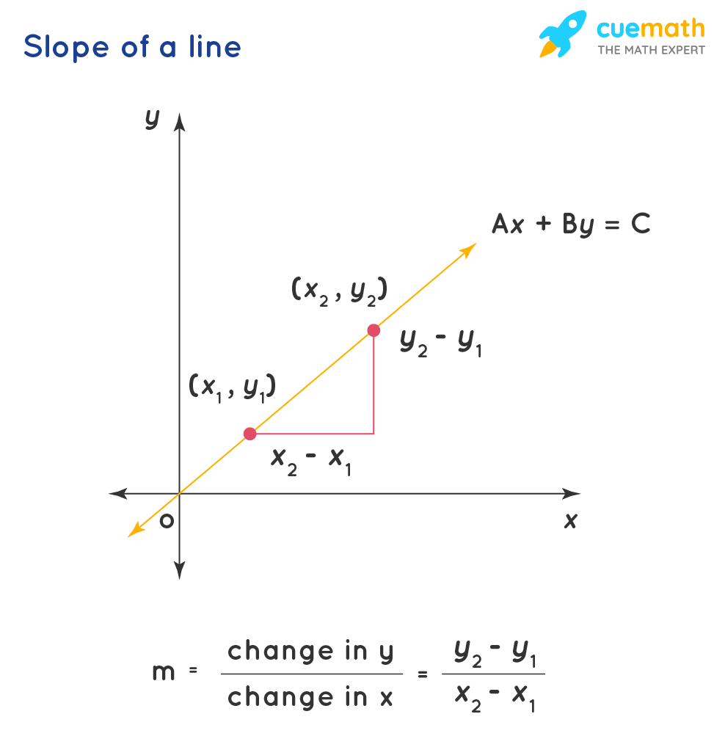
LINEAR REGRESSION

Slide 4
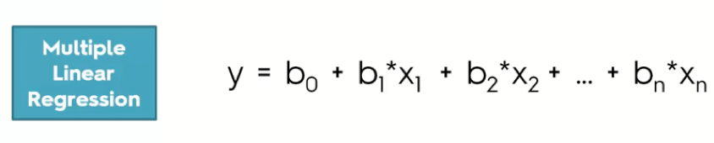
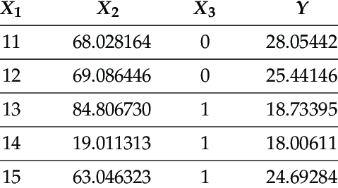
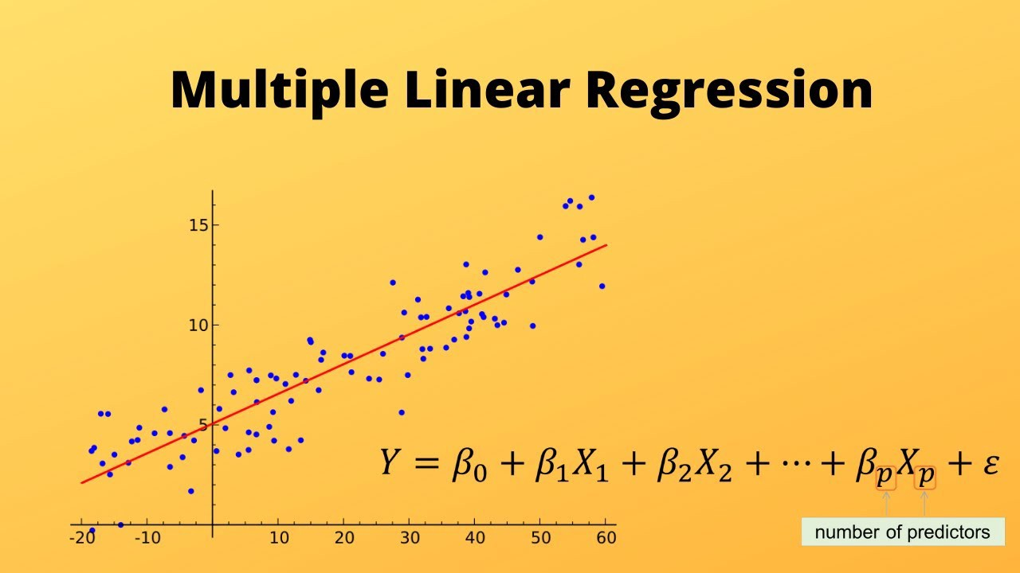
MULTIPLE LINEAR REGRESSION
Multiple Linear Regression: Multiple Linear Regression is used to estimate the relationship between two or more independent variables (X) and one dependent variable (Y).

Slide 5
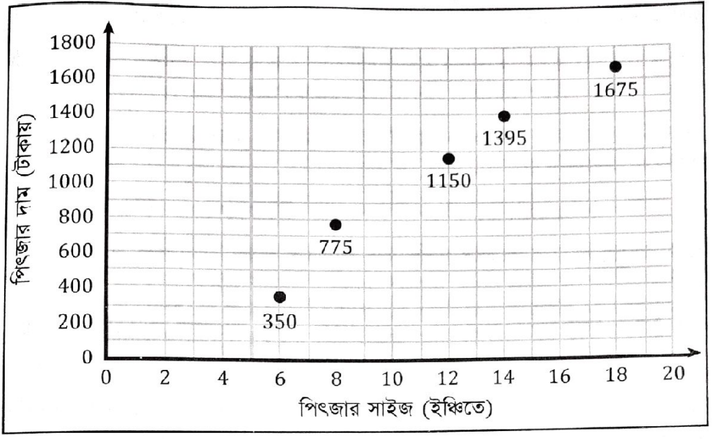
LINEAR REGRESSION

Slide 6
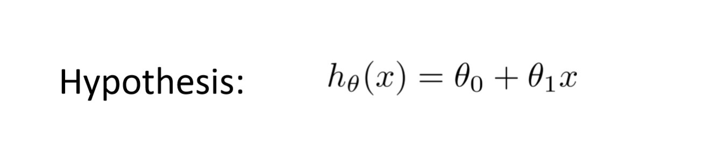
HYPOTHESIS FUNCTION
Hypothesis Function: An example of a model that approximates the target function and performs mappings of inputs to outputs is called a hypothesis in machine learning.

Slide 7

COST FUNCTION
Cost Function: By achieving the best fit regression line, the model aims to predict Y value such that the error difference between predicted value and true value is minimum. So, it is very important to update θo and θ1 values, to reach the best value that minimize the error between predicted Y value(pred) and true Y value (y).
Cost function (J) of linear regression is the Root Mean Squared Error (RMSE) between predicted Y value (pred) and true Y value (y).

Slide 8
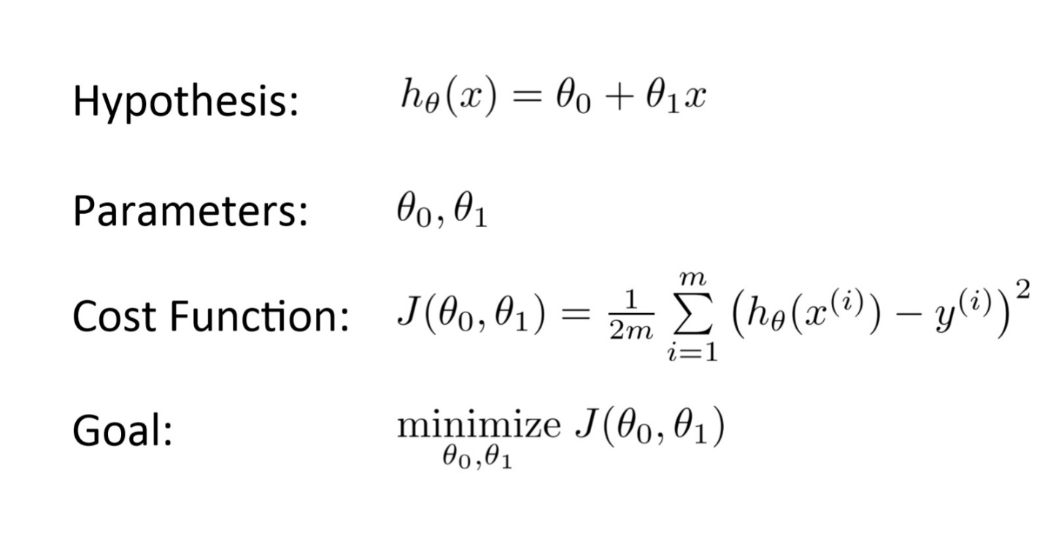
COST FUNCTION

Slide 9
GRADIENT DESCENT
Gradient Descent: To update θo and θ1 values in order to reduce Cost Function and achieving the best fit line the model uses Gradient Descent. The idea is to start with random θo and θ1 values and then iteratively updating the values, reaching minimum cost.
Gradient descent is an iterative optimization algorithm for finding the local minimum of a function.

Slide 10
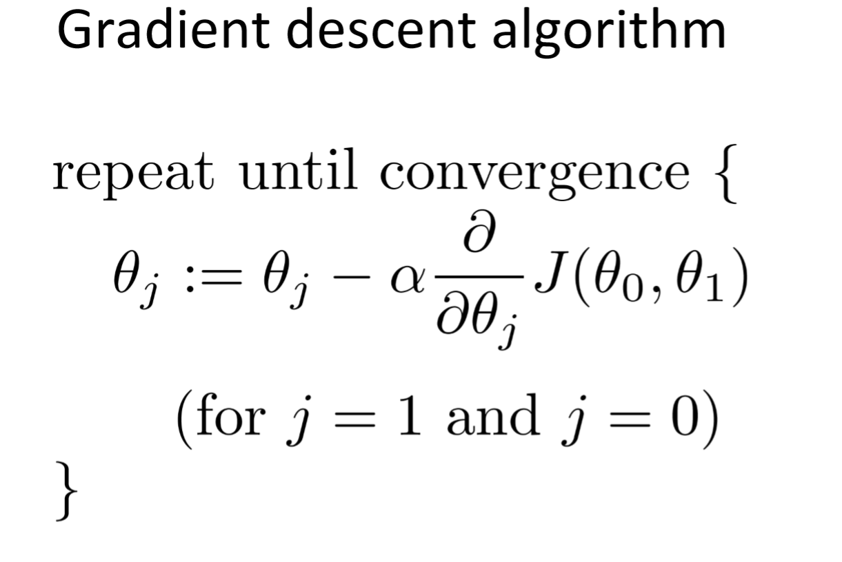
GRADIENT DESCENT

Slide 11
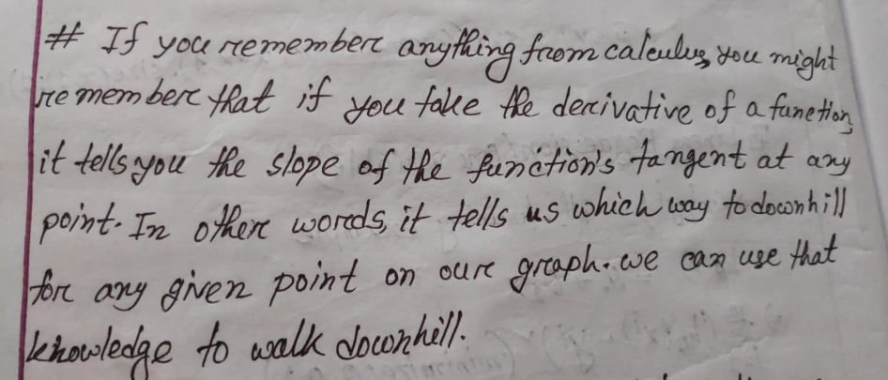
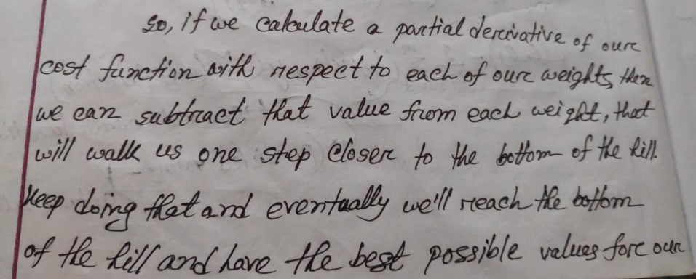
GRADIENT DESCENT
weights

Slide 12
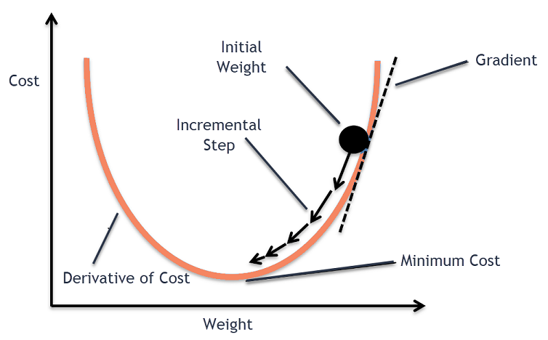
GRADIENT DESCENT
GRADIENT DESCENT CURVE

Slide 13
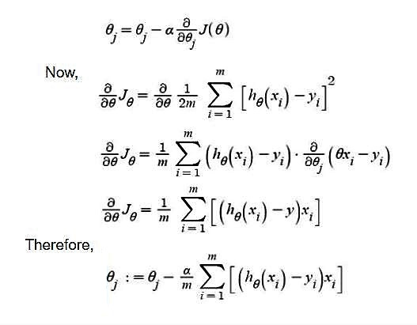
GRADIENT DESCENT

Slide 14
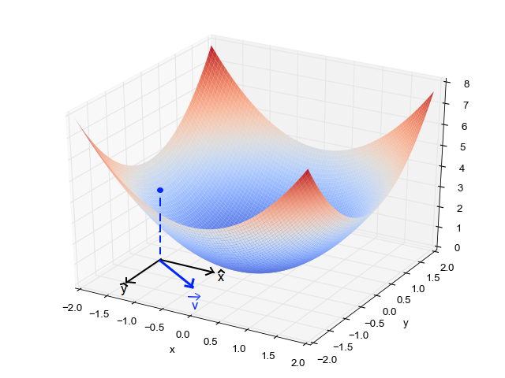
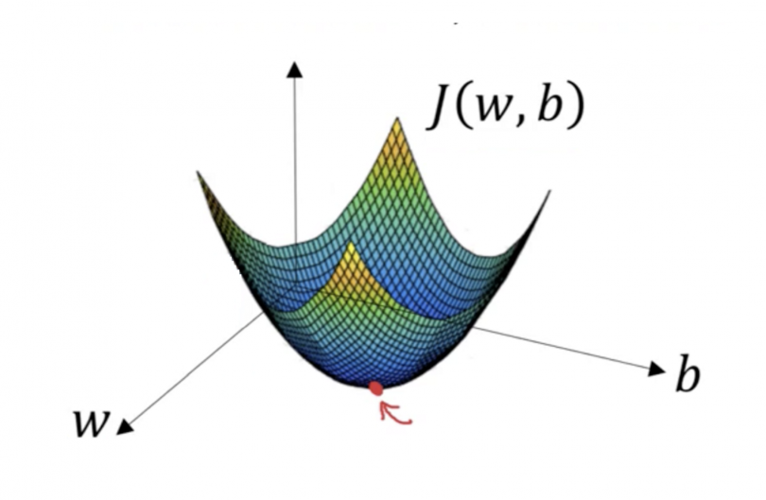
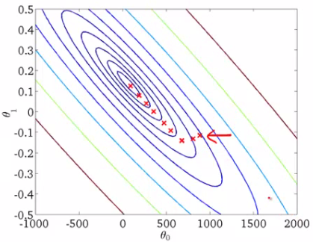
GRADIENT DESCENT
3D GRAPH (X,Y,J)
CONTOUR PLOT

Slide 15
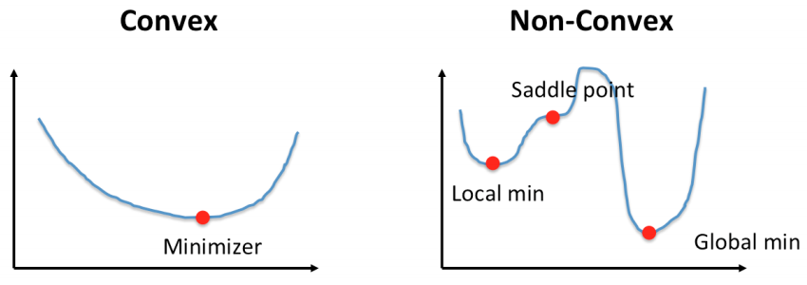
GRADIENT DESCENT
Convex & NonConvex: Convex and nonconvex are optimization problems. The basic difference between the two categories is that:
convex optimization there can be only one optimal solution, which is globally optimal or you might prove that there is no feasible solution to the problem.
While in nonconvex optimization may have multiple locally optimal points and it can take a lot of time to identify whether the problem has no solution or if the solution is global.

Slide 16
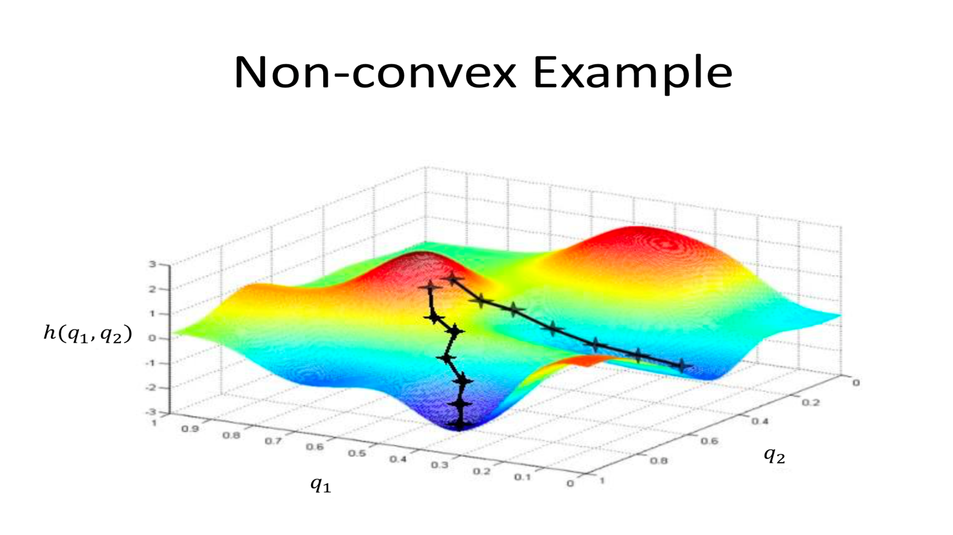
GRADIENT DESCENT

Slide 17
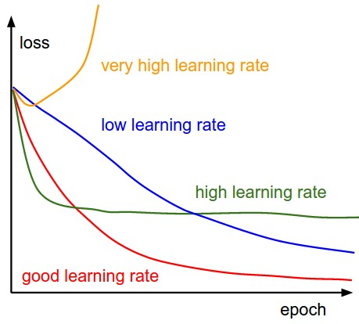
GRADIENT DESCENT
Learning Curves: A good way to make sure gradient descent runs properly is by plotting the cost function as the optimization runs. Put the number of iterations on the x-axis and the value of the cost function on the y-axis. This helps you see the value of your cost function after each iteration of gradient descent and provides a way to easily spot how appropriate your learning rate is.
GRADIENT DESCENT LEARNING CURVES

Slide 18
LEARNING RATE- α
Learning Rate (α): In Machine Learning and statistics, the learning rate is a tuning parameter in an optimization algorithm that determines the step size at each iteration while moving towards a minimum of a loss function.

Slide 19
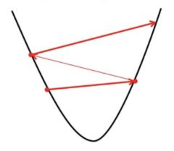
LEARNING RATE- α
Learning Rate(α-High): If we choose α to be very large, Gradient Descent can overshoot the minimum. It may fail to converge or even diverge.
High Learning Rate (α)

Slide 20
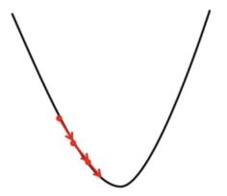
LEARNING RATE- α
Learning Rate(α-Low): If we choose α to be very small, Gradient Descent will take small steps to reach local minimum and will take a longer time to reach minimum.
Low Learning Rate (α)

Slide 21
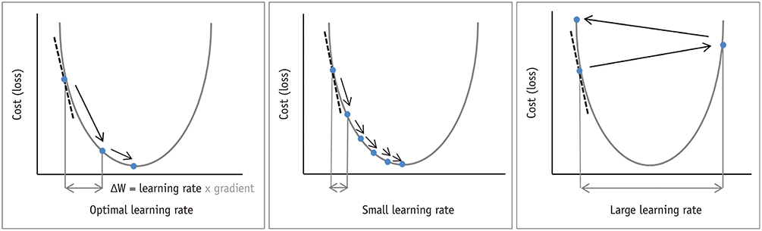
LEARNING RATE- α
Learning Rate(α-Good): The range of value to consider for the learning rate is less than 1.0 and greater than 10^-6. A traditional default value for the learning rate is 0.1 or 0.01, and this may represent a good starting point on your problem.

Slide 22
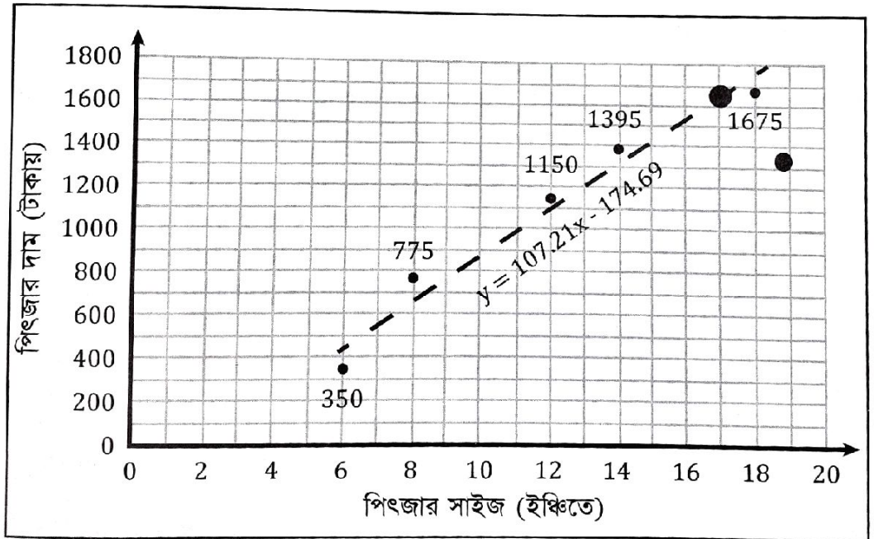
RESULT

Slide 23
EXAMPLE
Machine Learning Algorithm by Nafees Neehal-Bangla Book pdf version
Page No.: 71-(3.8)

